Slide 1

Bellevue DSC530 Fall 2021 Final Project
Michael Ersevim

Slide 2
The issue and the statistical question/hypothesis
Waste Management (WM) collects trash for millions of residential and commercial clients across the United States.
There are physical locations all over the country where they are responsible for picking up the trash.
However, for many reasons, there are plenty of locations where it is unfeasible for WM to pick up the trash and we sub-contract out the work.
In fact, almost 30% of the services for our commercial clients are done on our behalf by a third-party hauler.
The issue to be solved is one of predicting a cost that a third-party hauler (TPH) will charge our company for a service on our behalf.
The hypothesis is that there are variables which we can use to help predict the cost of a service certain areas.

Slide 3
The five variables considered in the modeling process:
Size of container – This is measured in cubic yardage and the most commonplace container sizes are 2, 4, 6 and 8 (cubic) yards. This variable is assumed a priori to be linearly linked to the cost of a service.
Material Type – Common materials contracted for pickups are Trash (T), Single Strem Recycling (SSR) and Cardboard (C ). Depending on the area and market forces, some materials can have a salvage value.
Frequency of Pickups per week – The most common pickup amounts are 1, 2, 3, 4, 5 6, and 7 times per week with most pickup occurring once or twice a week. This variable is also expected to be linearly linked to cost amount.
State/Zip code location – Zip code is the most difficult variable to relate to cost. It is a nominal variable and not linearly related to costs. Zip codes effectively represent certain market forces regarding competition and landfill costs.
Dates (ages when cost was effective) - This variable should be correlated with costs since overwhelmingly, costs increase over time. It can be used to quantify annual inflation amounts. It can indicate when there is a market disruption, such as a shortage of drives due to COVID, which causes increased costs for services.

Slide 4
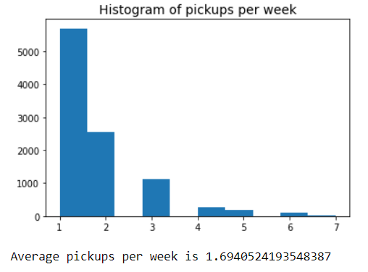
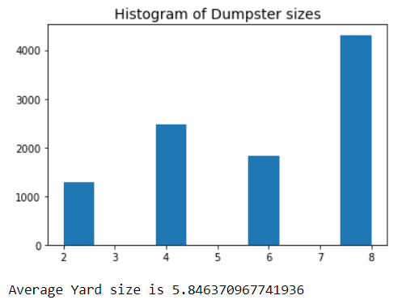
Histograms of the variables:
Histogram #1: Pickups per week – right skewed with a mean of 1.7 pickups per week.
Histogram #2: Dumpster sizes – left skewed with an average size of 5.8 cubic yards
#1 #2

Slide 5
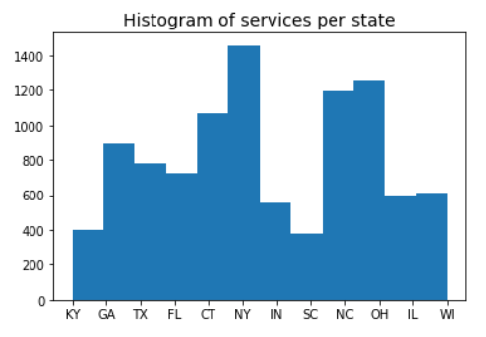
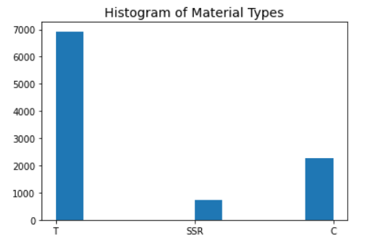
Histograms of the variables:
Histogram #3: Pickups per state – NY has the most services; KY and SC are the lowest
Histogram #4: Material Types – Trash (T) is by far the most common material
#3 #4

Slide 6
Outliers and descriptive statistics of variables
Frequency of pickups: there should be no values selected other than 1-7 days per week
State/Zip-codes: should all be 'valid', 5-digit values and valid state names/abbrevs
Outliers would include values that look like Canadian zip-codes, or numeric values above 99999
Size (in Yds): no amounts above 8 yards
The 'Where' SQL statement limits these values
Almost all WM dumpsters sizes are 2,4, 6, and 8-Yd sizes
Materials: Most common by far are Trash (T), Cardboard (C), and Single-Stream (SSR)

Slide 7
Outliers and descriptive statistics of variables
Costs of services:
Should all be positive and above a minimum 'reasonable threshold' (+/- 2.5 s.d.?)
One should look at individual states since costs can vary quite a bit across states
California or Hawaii have very high costs, so a value < $80 might be suspect
Mississippi has low costs, so a value of $30 is likely a valid amount
Both estimates above consider the cost of a 2-YD container picked up once a week

Slide 8
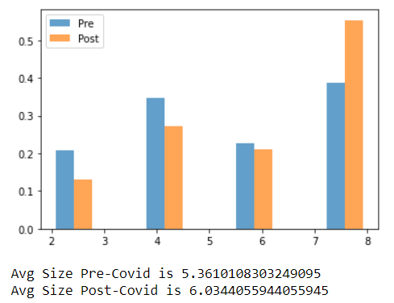
PMF comparing Pre- and Post-COVID dumpster sizes
The assumption is that after Covid hit, businesses scaled down their operations and dumpster sizes got smaller.
However, the pmf below shows that dumpster size grew post-Covid from 5.4 to 6.0 yards!

Slide 9
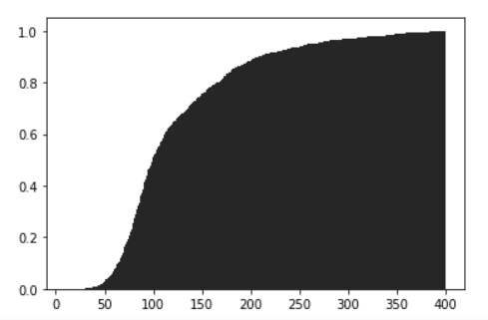
CDF of independent cost variable: Unit Cost for 4-Yd container
Below is a CDF of unitized costs for a 4-Yd container. It shows us that services costing more than $350 are rare, and the steepest portion between $60 and $150 contains the majority of services. These understanding match with the expectations of management.

Slide 10
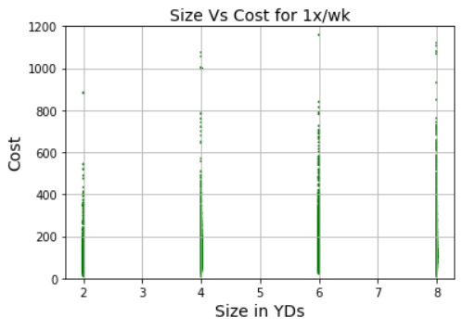
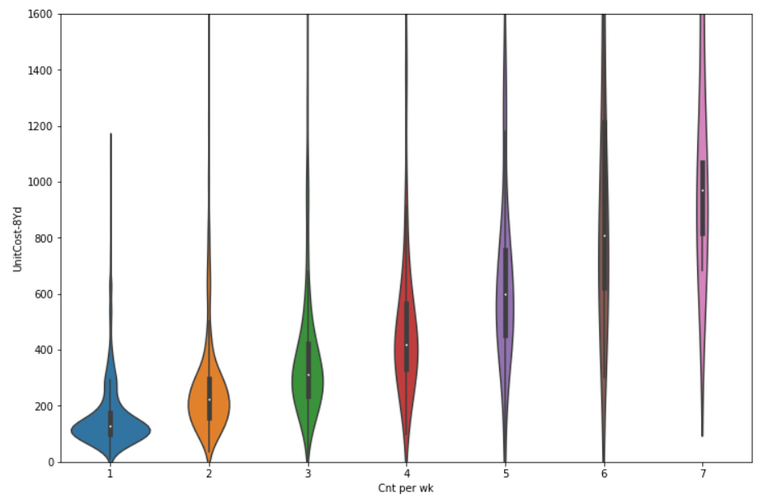
Scatter plots variables:
Violin plot #1 - pickups per week (freq) vs cost: there is a positive correlation and causation between services/week and increased costs due to more work (*Note: a violin plot better showed the density of costs than a scatter given the discrete pickups)
Scatter plot #2 - size of dumpster vs cost: there is a positive correlation (and causation!) between size of dumpster and increased cost due to increased disposal costs
#1 #2

Slide 11
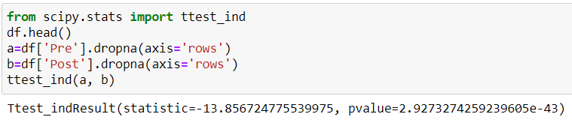
Hypothesis testing: difference in means:
Below, we are testing the difference in the Pre and Post-Covid mean of dumpster size.
The t-statistic of –13.9 and a p-value of essentially 0 are telling us that there is virtually NO chance the means of dumpster size pre and post Covid are the same and that the differences are due to only sampling error

Slide 12
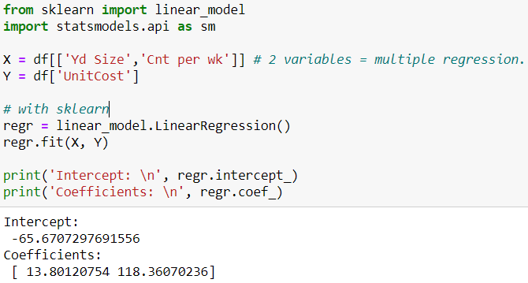
Regressing cost on size & freq:
Python code used to conduct a regression analysis on one dependent and two explanatory variables, Size (in Yds) and Frequency (Cnts per week).
The coefficients tell us for each Yard larger the container is, the cost increases by $13.80 and for each increase in counts per week, the cost goes up $118.36

Slide 13
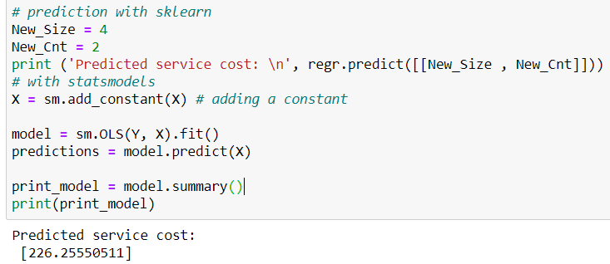
Predicting cost using size & freq:
Python code used to estimate cost (the dependent variable)
Note we are setting Size = 4Yds and Cnts per week = 2
The estimate of $226 is reasonable

Slide 14
Thanks for a great semester!
Bellevue DSC530 Fall 2021
Michael Ersevim

